Slide 1
A Comparison of Complex Hydraulic Modeling along Crabtree Creek
August 29, 2024 | National Hydraulic Engineering Conference

Slide 2
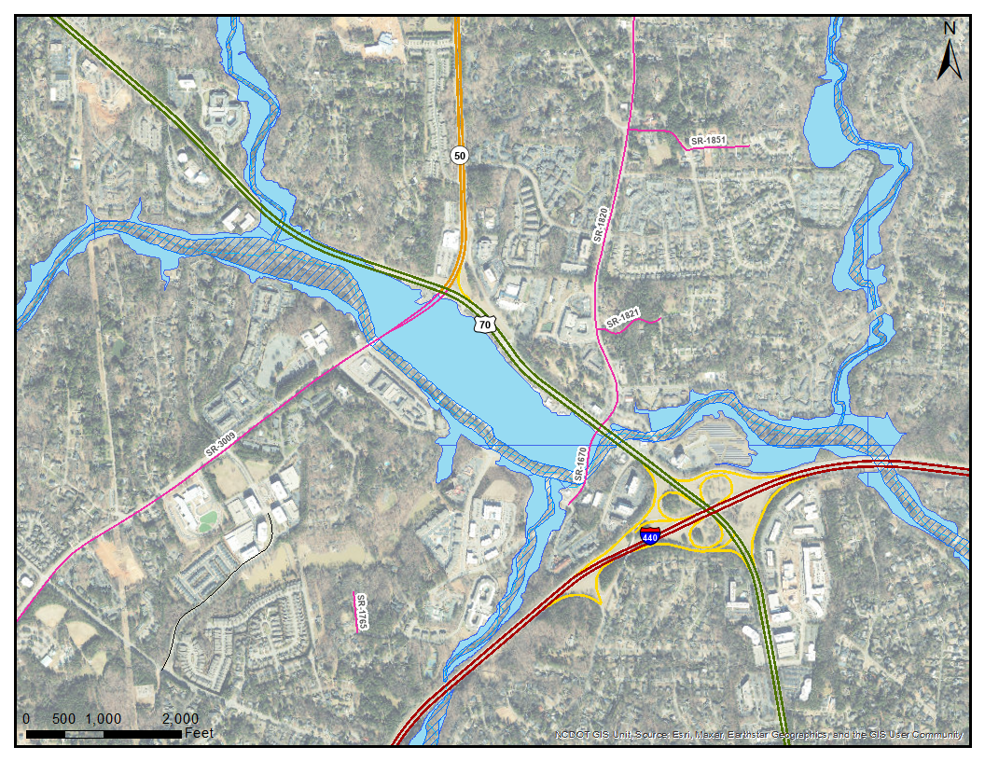
Project Background
Project located along Crabtree Creek in vicinity of Crabtree Valley Mall
NCDOT STIP Project I-5870 proposes improvements to:
I-440/U.S. 1 interchange at U.S. 70 (Glenwood Avenue)
Glenwood Avenue and Blue Ridge Road/Lead Mine Road
Possible new connection to Crabtree Valley Avenue
Area selected for comparison of 1D HEC-RAS, 2D HEC-RAS, and SRH-2D
Notes:
As part of STIP Project I-5870, NCDOT is proposing a set of improvements in the vicinity of Crabtree Valley Mall located in northwest Raleigh that will impact Crabtree Creek and its tributaries. The scope of project I-5870 is expected to include improvements at the I-440/U.S. 1 interchange at U.S. 70 (Glenwood Avenue), the intersection of Glenwood Avenue and Blue Ridge Road/Lead Mine Road, a possible new connection to Crabtree Valley Avenue, and other revisions to the road network within the project area.
The project site is hydraulically complex including multiple bridges, culverts, stream confluences, and Crabtree Mall, which is completely contained within the floodplain. NCDOT selected this project site for a comparison to test the capabilities of each program and to determine the accuracy of the model results.

Slide 3
Complex Hydraulics
Notes:
Discuss ineffective flow area demonstrated by vortices in flow patterns.

Slide 4
Model Comparison
 | SRH-2D | 2D HEC-RAS
Developed/Supported By | USBR + FHWA Aquaveo (SMS) | USACE
Primary GUI | SMS | RASMapper
Numerical Method | Finite Volume | Finite Volume
Model Version Used | 3.5.0 (SMS 13.2.13) | 6.3.1
Mesh | Quad (Refinement Regions) | Triangular and Quad (Mesh Density can Vary Gradually)
Roughness/Manning’s N Value | Roughness Polygon applied to Mesh (Can be Depth Varied) | Roughness Polygon applied to Mesh
Boundary Condition | Normal (Average Slope used to Generate Rating Curve) | Normal with Computed Slope
Bridges | 2D with Piers as Holes in Mesh | 1D (2D Connections)
Culverts | 1D (HY-8) | 1D (2D Connections)
Obstructions | Holes in Mesh | Terrain Alteration
Notes:
Highlight that main differences between models occur in mesh development, bridge representation, and coding of obstructions.

Slide 5
Model Setup – Mesh and Terrain
SRH-2D
Meshing
Default triangular
Quad recommended for channel and embankments
Cell size controlled by node spacing along boundaries and breaklines
Terrain Utilization
Terrain value captured at corner of each cell
HEC-RAS
Meshing
Default quad/irregular mesh
Cell size controlled by assigned 2D area
Refined with breaklines and refinement regions
Terrain Utilization
Cross section at each cell face
Elevation-Area curve for each cell

Slide 6
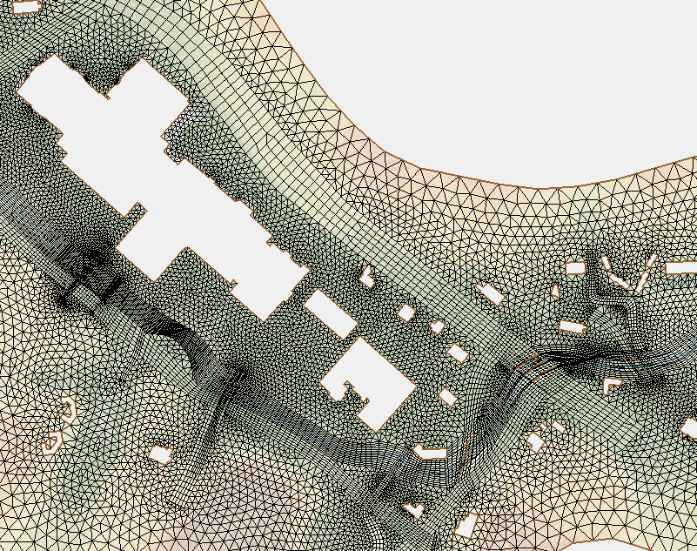
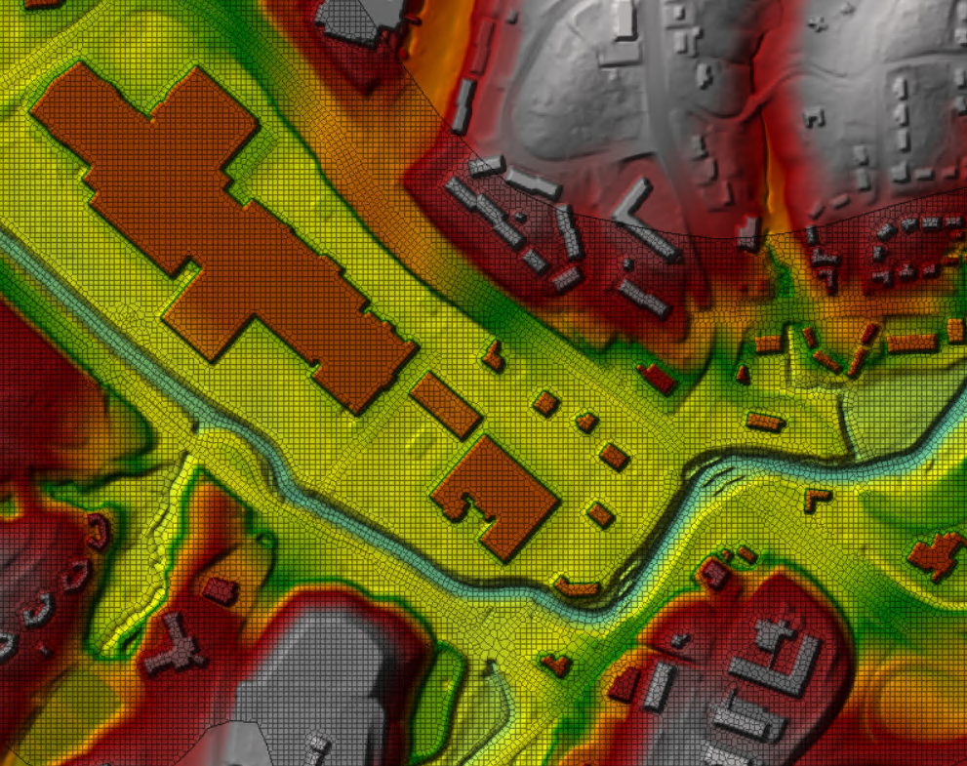
Model Setup – Mesh and Obstructions
SRH-2D
HEC-RAS 2D

Slide 7
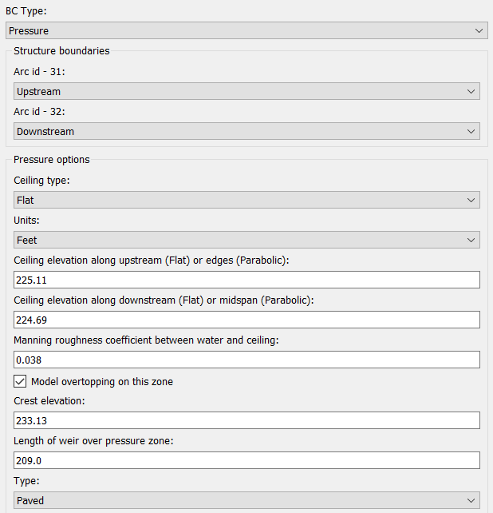
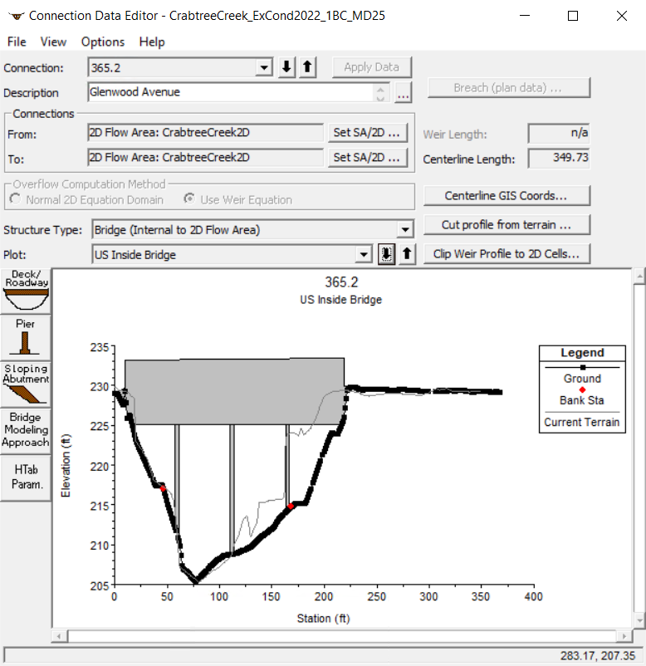
Model Setup – Bridges
SRH-2D
HEC-RAS 2D

Slide 8
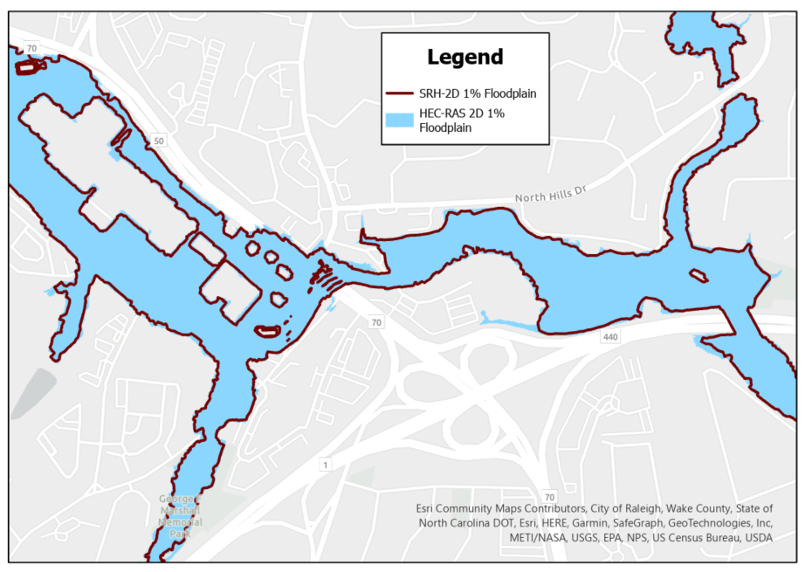
Model Results (1)
Both 2D models provided very similar results
Notes:
ZOOM IN TO AN AREA OF THE FLOODPLAIN?
Inundation boundary shapefiles and water surface elevation rasters were generated for each event. The extents of the 2D models were very similar. However, differences in the way that the RASMapper and SMS mapping algorithms handle floodplain boundaries, along with the slight differences in water surface elevation, result in minor variations such as the “spit” of water along I-440 exit ramp from the westbound lanes seen in the HEC-RAS 2D floodplain.

Slide 9
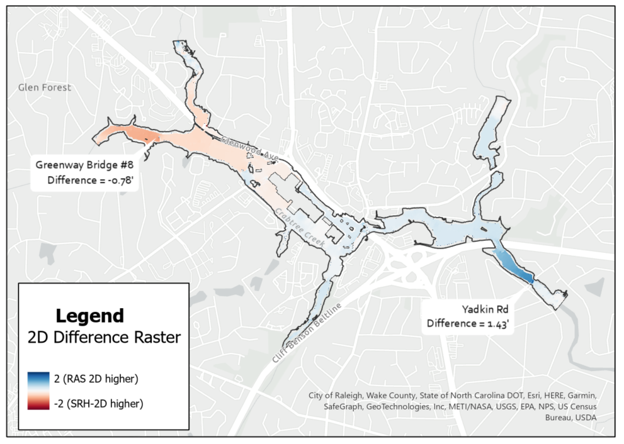
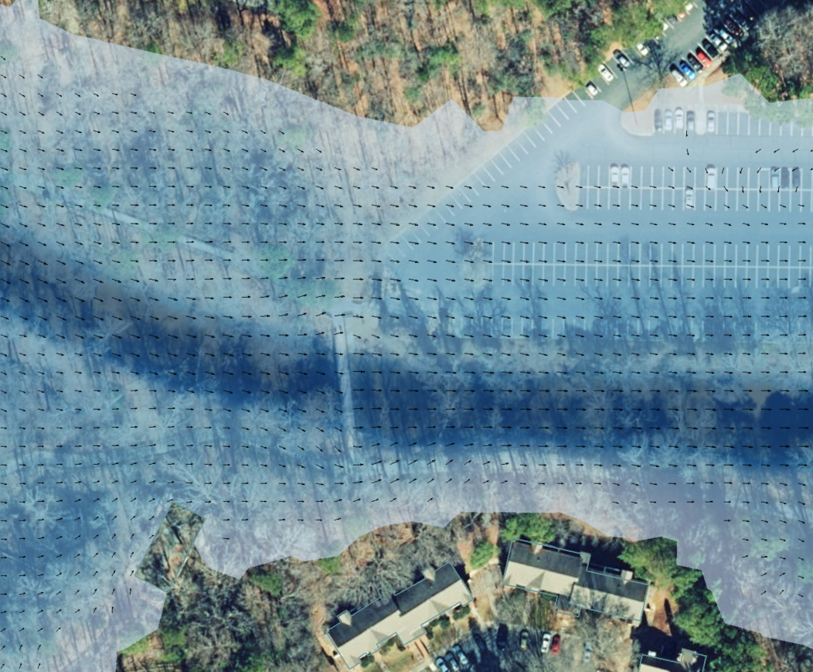
Model Results (2)
Water Surface Elevations departed at two (2) locations
Notes:
The highest differences were observed upstream of Yadkin Road and Greenway Bridge #8 where the HEC-RAS 2D model produces results that are approximately 1.4 feet higher than the SRH-2D results (Figure 10). These differences appear to stem from the different structure calculation methods that SRH-2D and HEC-RAS 2D utilize. In particular, some of the empirical equations that HEC-RAS uses for low flow (no overtopping) scenarios tend to provide conservative results, as seen at Yadkin Road, while SRH-2D pressure boundary conditions at small bridges with significant overtopping tend to provide more conservative results. This is the scenario at Greenway Bridge #8 where the SRH-2D model is approximately 0.8 feet higher than the HEC-RAS 2D model.

Slide 10
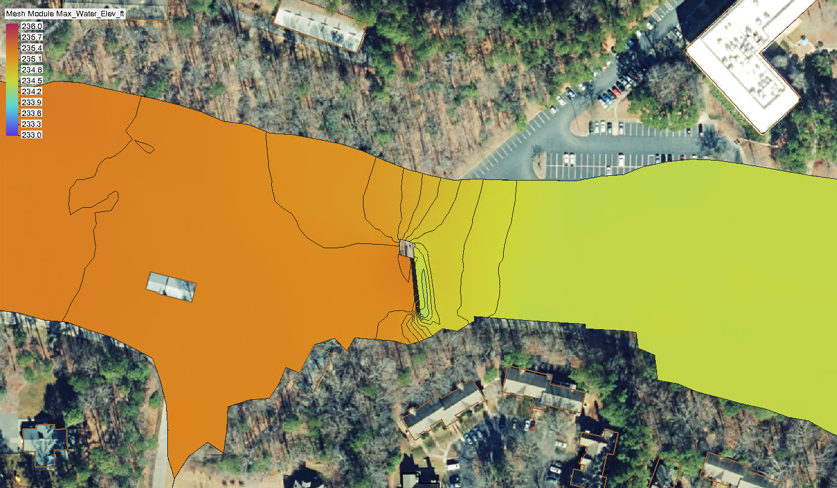
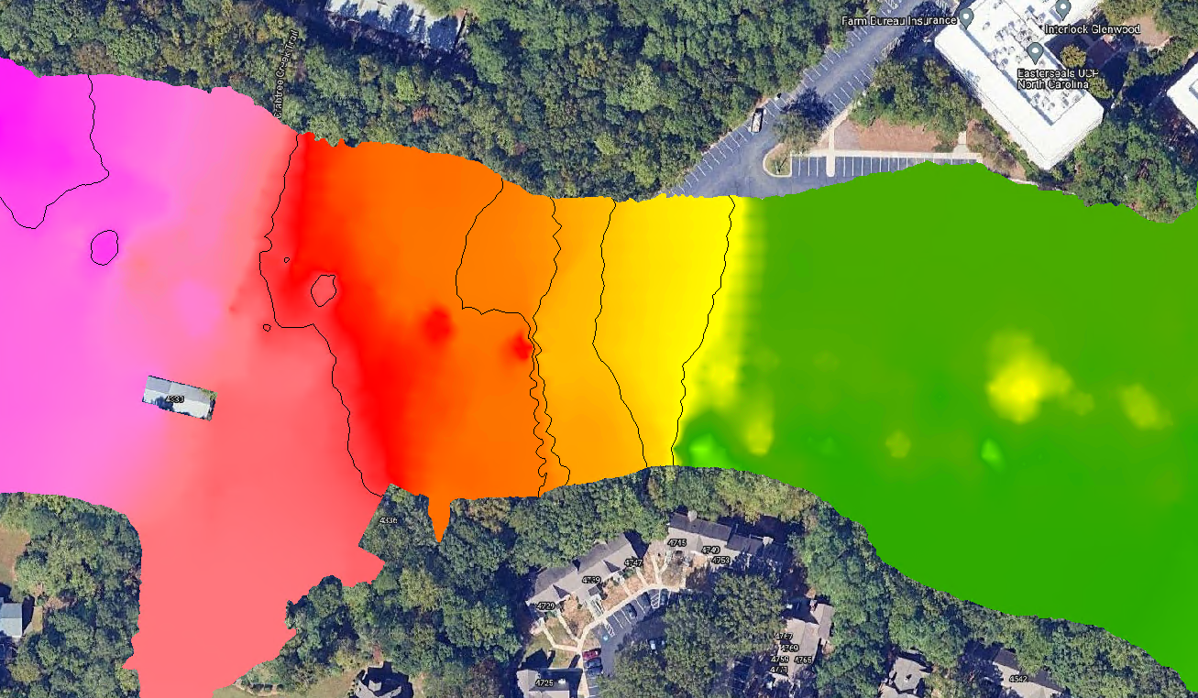
Model Results at Greenway Bridge #8
SRH-2D model produces results 0.8’ higher than HEC-RAS 2D
Difference driven by mesh representation of underlying terrain
SRH-2D Water Surface – Floodplain Width: 205’ | HEC-RAS Water Surface – Floodplain Width: 270’

Slide 11
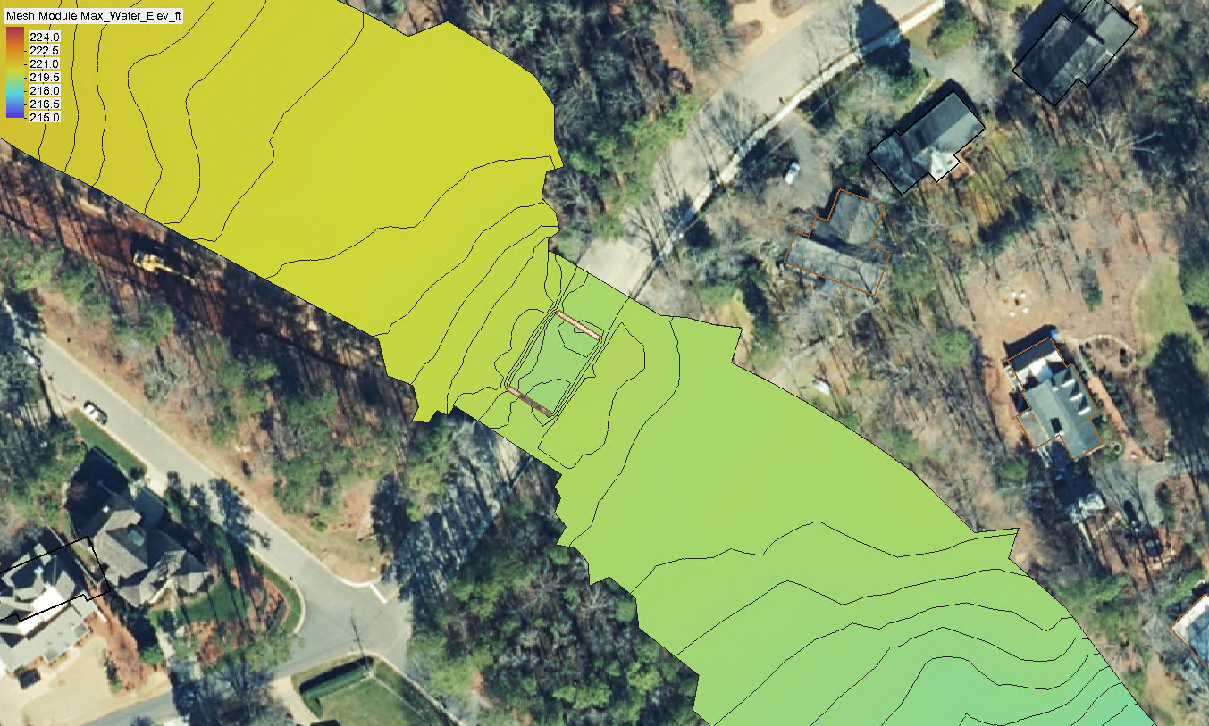
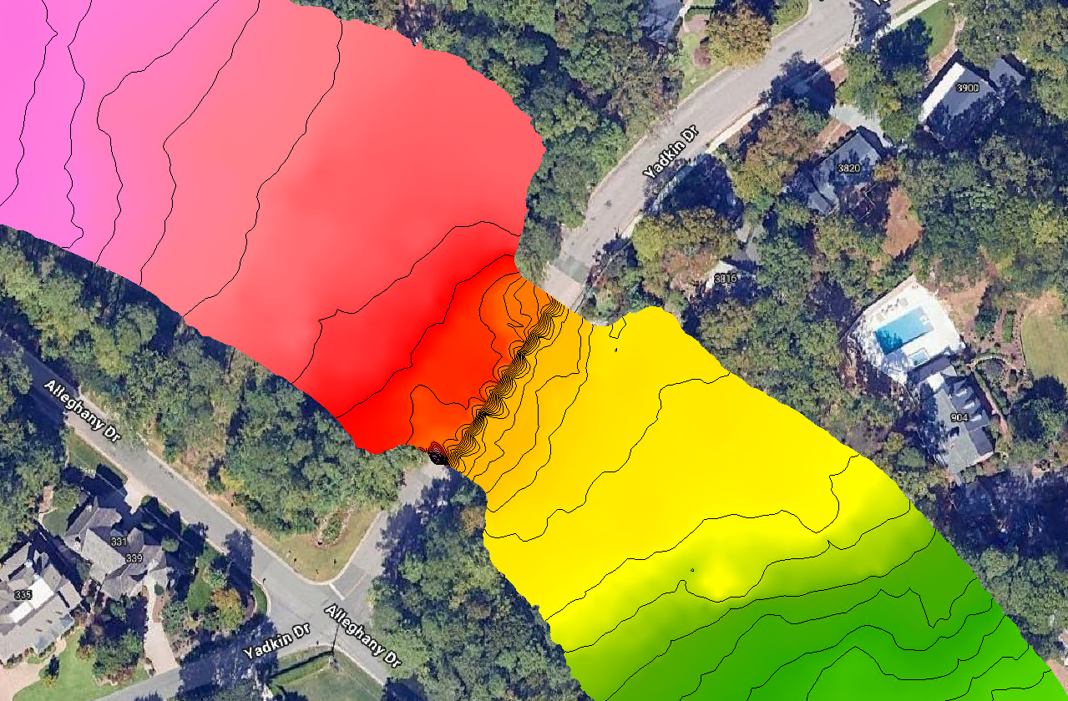
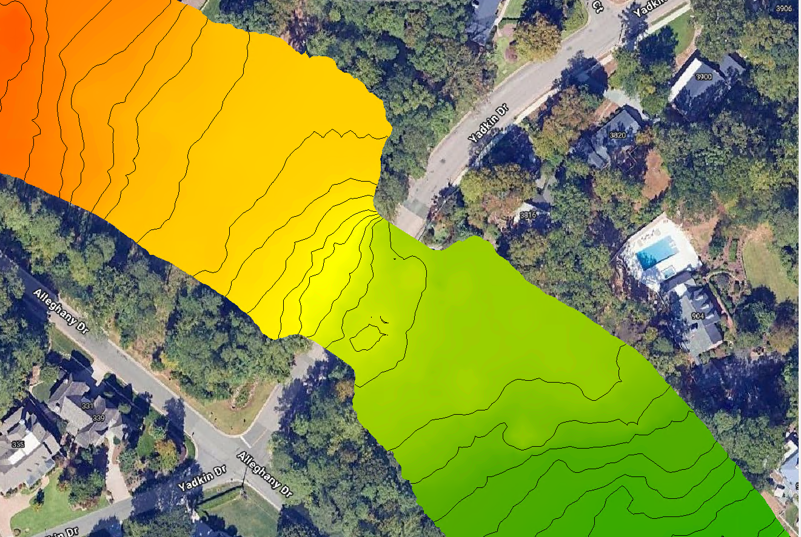
Model Results at Yadkin Dr
HEC-RAS 2D produced results 1.4’ higher than SRH-2D
Difference driven by piers
SRH-2D Water Surface | HEC-RAS 2D Water Surface (Momentum Equation) | HEC-RAS 2D Water Surface (Energy Equation)

Slide 12
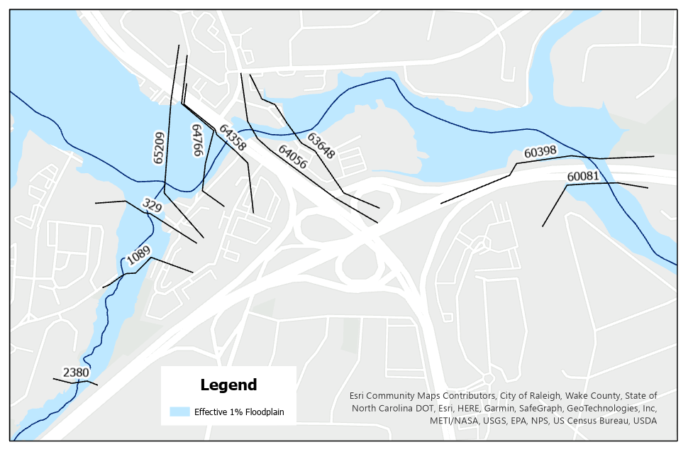
Model Results (3)
2D results were about 2 feet higher than the 1D effective model
 | 1D HEC-RAS |  |  | 2D HEC-RAS |  |  | SRH-2D
Cross Section | WSEL (FT) | Flow (CFS) | Velocity (FPS) | WSEL (FT) | Flow (CFS) | Velocity (FPS) | WSEL (FT) | Flow (CFS) | Velocity (FPS)
65209 | 229.01 | 11,056 | 5.85 | 230.88 | 9,900 | 4.9 | 230.90 | 10180 | 4.7
64766 | 228.51 | 11,056 | 3.8 | 230.14 | 10,010 | 5.8 | 230.40 | 10060 | 5.5
64358 | 227.49 | 11,056 | 7.73 | 229.37 | 9,999 | 5.9 | 229.50 | 10046 | 5.0
64056 | 226.54 | 11,056 | 6.12 | 228.3 | 9,983 | 6.7 | 228.30 | 10025 | 6.1
63648 | 224.68 | 11,056 | 7.13 | 227.31 | 9,927 | 7.3 | 227.00 | 10020 | 7.1
60398 | 222.46 | 11,542 | 5.89 | 224.37 | 10,001 | 4.9 | 223.70 | 10200 | 5.1
60081 | 221.63 | 11,542 | 7.20 | 223.88 | 10,000 | 6.0 | 223.00 | 10200 | 6.6
Notes:
Note the same Manning’s N values were used for all model setups.

Slide 13
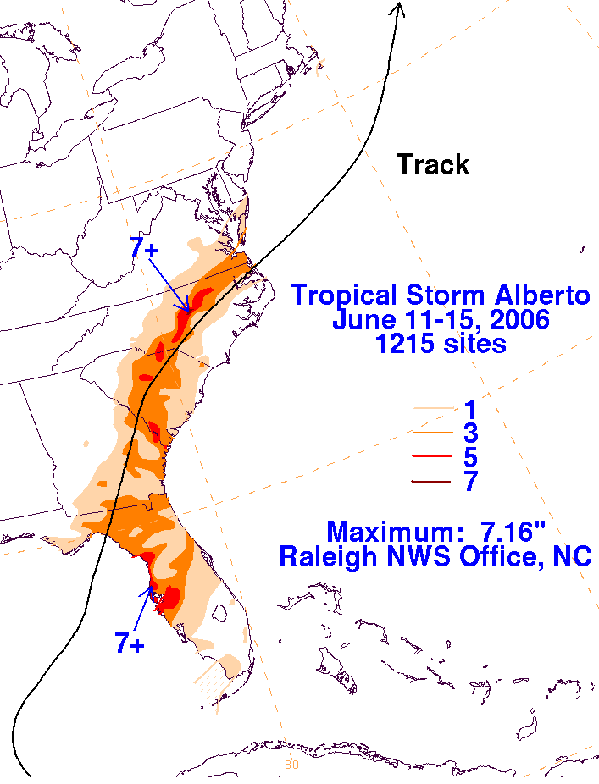
Model Calibration
Manning’s n % Change | HEC-RAS 1D | HEC-RAS 2D | SRH-2D
+40% | 226.63 | -- | --
+25% | 226.08 | -- | --
Reference Values | 225.25 | 227.96 | 227.75
-20% | -- | 226.93 | 226.42
-25% | -- | 226.68 | 226.18
-30% | -- | 226.43 | 225.86
Image curtesy of NOAA: https://www.wpc.ncep.noaa.gov/tropical/rain/alberto2006.html
Notes:
Third highest reading on record at the gage at Glenwood Avenue. Equivalent to approx. 50-year storm event.
Manning’s N values were adjusted to better align modeled WSELs with measured readings. The Manning’s N values for the 2D models needed to be reduced by 20-25% to calibrate the model while the roughness values for the 1D model were increased to better align with measured elevations.

Slide 14
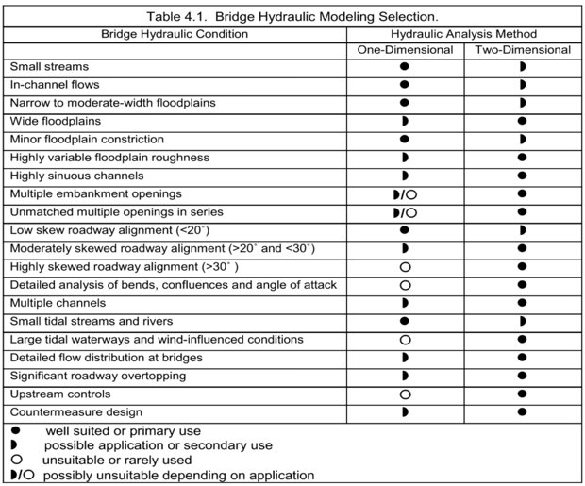
Recommendations
FHWA Hydraulic Design Series No. 7 – Hydraulic Design of Safe Bridges (Table 4.1)
Selection matrix for 1D vs 2D models
Notes:
This table was the inspiration for the recommendation table we produced as part of our study. This is an often-referenced table from the FHWA that assists with selecting whether a 1D or 2D model is appropriate for the hydraulic condition.

Slide 15
Recommendations
Hydraulic Condition | HEC-RAS 2D | SRH-2D
Low Detail Models (BLE)
Large Models**
Longitudinally Sloped Decks
Culverts
Rain on Grid
Detailed Mesh/Geometry Requirements
Complex Pier Geometry
Complex Overtopping
Floodway Analysis
Sediment Transport
**Fewer HEC-RAS cells capture more terrain variation due to cell faces acting as cross sections
Notes:
State that this is not official guidance and is based on our experience on this one project at this one site. We encourage others to add to this, modify it, etc. to add their experience and knowledge. However, we wanted to provide our opinion (as modelers) as to how the strengths of HEC-RAS and SRH-2D compare and to provide a decision support tool for modelers selecting between different programs.
Complex Geometry includes historical piers upstream/downstream of structure, wildlife crossings, barricades that control overtopping flow and location.

Slide 16
Matt Lauffer, PE, CPM
State Hydraulics Engineer
mslauffer@ncdot.gov
Emma Bones, PE
Water Resources Engineer
ebones@dewberry.com
QUESTIONS?

Slide 17
Model Setup
Attribute | SRH-2D | HEC-RAS 2D
Version | SMS 13.2 / SRH-2D 3.5 | 6.3.1
File size (with results) | 17.1 GB | 24.2 GB
Number of mesh cells | 75,669 | 85,789
Average mesh element size | 460 SF | 410 SF
Model time window | 10 Hours | 10 Hours
Computational time step | 4 Seconds | 4 Seconds
Run time | 40 Minutes | 40 Minutes
Cores used | 1 | 4

Slide 18
Model Setup MANNING’S N VALUES
LAND USE CATEGORY | Reference Value | SRH-2D Final Manning’s n | HEC-RAS 2D Final Manning’s n | HEC-RAS 1D Final Manning’s n
Barren | 0.10 | 0.08 | 0.075 | 0.125
Building | 0.50 | 0.50 | 0.50 | --
Channel | 0.038 | 0.030 | 0.027 | 0.048
Developed | 0.09 | 0.072 | 0.068 | 0.112
Maintained Grass | 0.06 | 0.048 | 0.045 | 0.075
Open Water | 0.03 | 0.024 | 0.022 | --
Pavement | 0.015 | 0.012 | 0.011 | 0.019
Wetlands | 0.10 | 0.080 | 0.075 | 0.125
Woods | 0.12 | 0.096 | 0.09 | 0.15
Notes:
Starting Manning’s N values before calibration.

